Slide 1

MATHEMATICAL PROBLEM POSING AS A LINK BETWEEN ALGORITHMIC THINKING AND CONCEPTUAL UNDERSTANDING
SERGEI ABRAMOVICH
STATE UNIVERSITY OF NEW YORK AT POTSDAM, USA

Slide 2

Oberwolfach, Germany
MathEd Workshop: Mathematics in undergraduate study programs: Challenges for research and for the dialogue between mathematics and didactics of mathematics

Slide 3
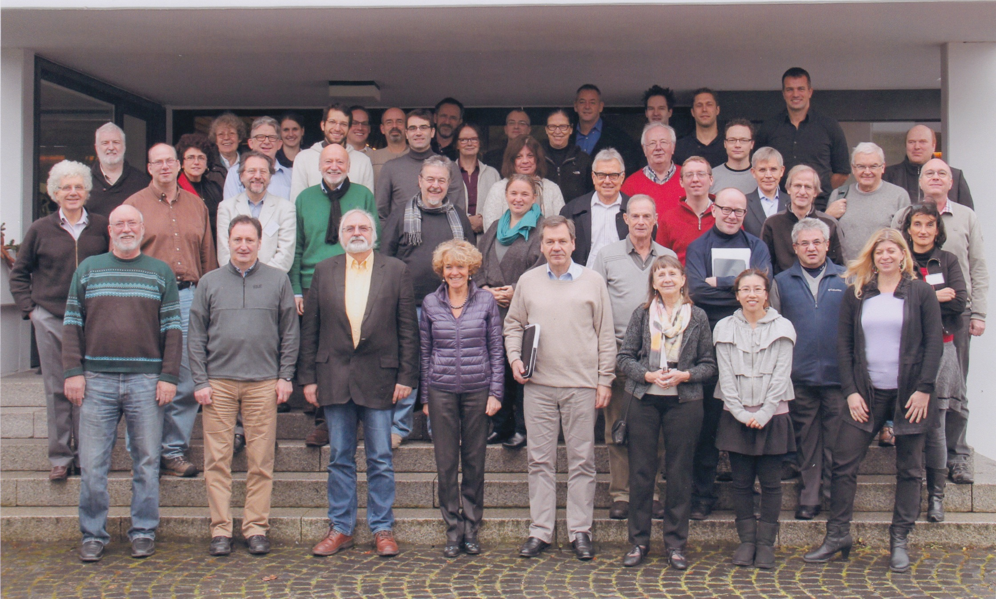
Participants of the workshop

Slide 4
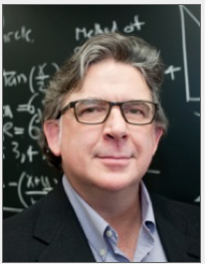
William McCallum
University of Arizona
(Common Core author)
Oberwolfach talk:
“Mathematicians and educators: Divided by a common language”
The two groups have the dichotomy of perspectives on the relationship between conceptual understanding and algorithmic thinking

Slide 5


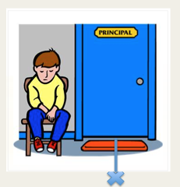
1980s – the first (educational) publications
Gelman & Meck (1983):
Basic counting principles have to be
developed to use counting as a skill
by analogy with grammar,
“implicit and explicit knowledge of counting principles” among preschoolers
The triangle inequality
The shortest distance

Slide 6
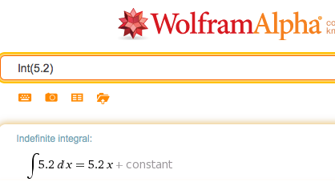
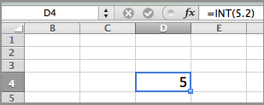
Conceptual vs. procedural in the digital era
Nesher (1986): duality between using technology with and without thinking
Kaput (1992): “exercise of procedural is supplanted (rather than supplemented) by machines
Kadijevich (2002): computations “require the user to think conceptually before a procedure is used”

Slide 7
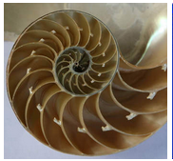
Conceptual and procedural develop iteratively through posing and solving problems
Rittle-Johnson, Siegler & Alibali (2001):
“conceptual and procedural knowledge [in mathematics] develop iteratively, with increases in the one type of knowledge leading to increases in the other type of knowledge, which trigger new increases in the first”

Slide 8

Proposal
Considering the relationship between algorithmic thinking and conceptual understanding as an iterative alliance leads to the interpretation of problem posing as a recurrent reflection on a solved problem through the cycle “solve-reflect-pose”.

Slide 9
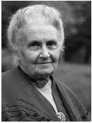
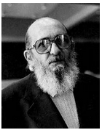
Mathematical problem posing as an educational philosophy
Montessori – “the liberty of the pupil” (student-centered classroom) … tendency towards independence … encouraging factor in students’ posing their own (mathematical) problems
Freire – “problem-posing education … looking at the past … [to] more wisely build the future” … learning of mathematics

Slide 10
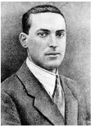
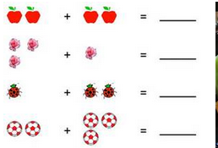
Mathematics begins with posing problems and it evolves from concrete activities expressed (in Vygotsky’s words) through the first order symbols to abstract concepts using the second order symbolism

Slide 11

Two levels of conceptual understanding
(by analogy with Gelman & Meck’s implicit and explicit counting principles)
Basic conceptual understanding – necessary to activate problem solving.
Advanced conceptual understanding – necessary to continue problem solving, to find an efficient solution, to pose a similar problem, to answer a new question.
Counting the number of outer edges (perimeter of the cross).

Slide 12
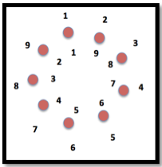
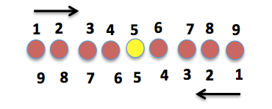
Isaacs N. (1930): questions seeking information (the first order questions) and questions requesting specific type of explanation (the second order questions).
How many counters are there?
Why when counting in different directions a counter may or may not get the same label?

Slide 13
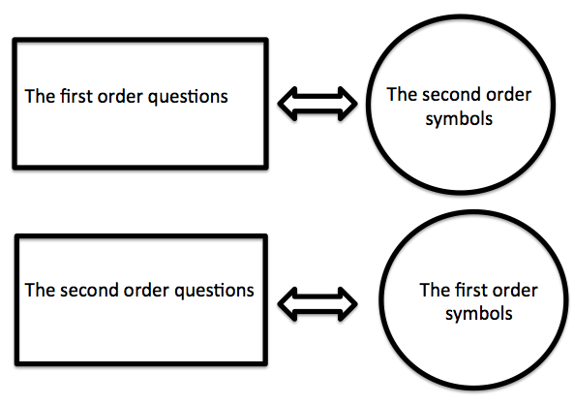


Duality of questions vs. duality of symbols
The modern student develops
“the ability to decontextualize [from the first order symbols] and contextualize … in order to probe into the referents for the [second order] symbols involved” (CCSS, 2010, p. 6)
36
?
(1+2+3)²
1³+2³+3³

Slide 14
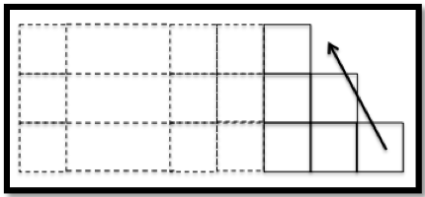
Problem (adopted from McCallum’s talk).
The sum of three consecutive natural numbers is equal to 81. Find the numbers.
BCU: using the second order symbolism
x+x+1+x+2=81; 3x=78; x=26, 26+1=27, 26+2=28.
ACU: using the first order symbolism
81 ÷ 3 = 27; 27 – 1 = 26; 27 + 1 = 28.

Slide 15
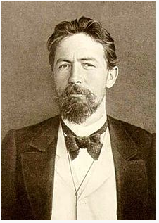
Looking at the past:
From mathematics curriculum of the
19th century (Tchehov’s Tutor)
If a merchant buys 138 yards of cloth, some of which is black and some blue, for 540 rubles, how many yards of each did he buy if the blue cloth cost 5 rubles a yard and the black cloth 3?
BCU (guess): 138 = 100 + 38 (meters)
Assumed payment: 3×100 + 5×38 = 490 (rubles)
ACU : the difference between the actual and assumed payments has to be a multiple of the difference in prices for a yard of blue and a yard of black cloth.
Purely computational algorithm (involving rubles):
540 – 490 = 50; 5 – 3 = 2; 50 ÷ 2 = 25;
100 – 25 = 75; 38 + 25 = 63

Slide 16
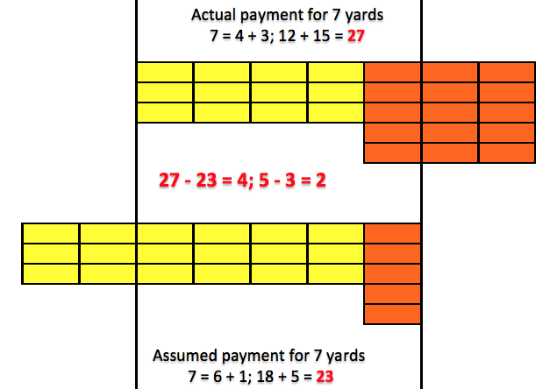
ACU through the second order symbols

Slide 17
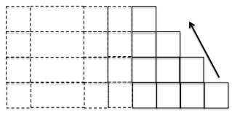
Posing McCallum-like problem
The sum of four consecutive natural numbers is equal to 81. Find the numbers.
Changing the numbers involved

Slide 18
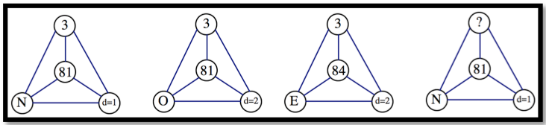
ACU is necessary for posing a similar problem
The sum of three consecutive natural numbers is equal to 80 (84) ...
From conceptual to procedural
The apex holds the conceptual bond

Slide 19
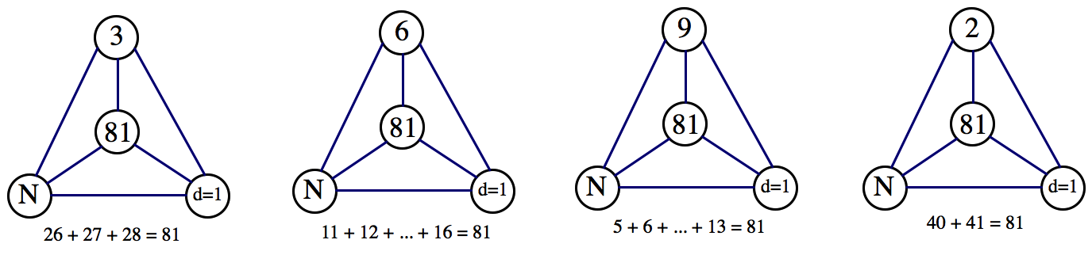
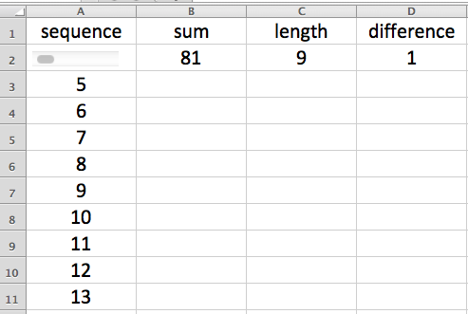
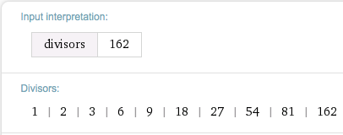
Solve-reflect-pose
Variation of the number of terms yields multiple solutions to a McCallum-like problem

Slide 20
From algorithmic to conceptual and back:
An (educative) example
If S is prime then n = 2 and x = (S – d)/2, thus d is an odd number.
Prime number cannot be partitioned in three or more integers in arithmetic progression.
Proof: p = x + x + d +...+ x + (n -- 1)d = n(x + d)

Slide 21
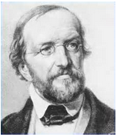
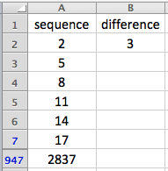
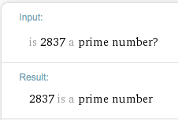


Conceptual result – procedural demonstration
Dirichlet prime number theorem:
If gcd(d, x) = 1, d ≥ 2, x = 0, then there are infinitely many primes among the arithmetic sequence x_{n} = x + dn.

Slide 22

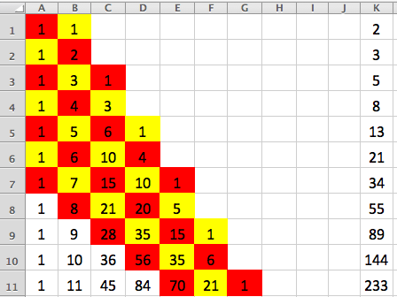
Problem posing in the digital era
BCU: Pascal’s triangle
ACU: Fibonacci-like polynomials don’t have complex roots
Maple-based proof for n ≤ 100

Slide 23
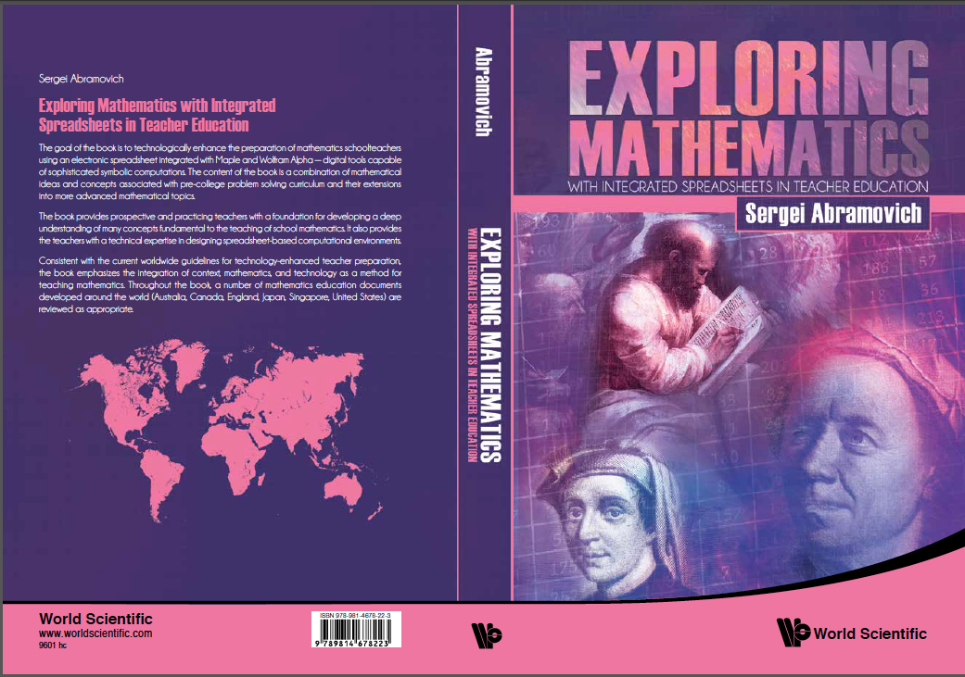
2015

Slide 24
Conclusion
Problem posing in the digital era: integration procedures and concepts
ACU and BCU
First and second order symbols/questions
Asking conceptual questions about mundane procedures
Solve-reflect-pose starts with BCU, develops ACU used as BCU at the next level, and so on
Educational problem posing may lead to significant conceptual outcomes

Slide 25
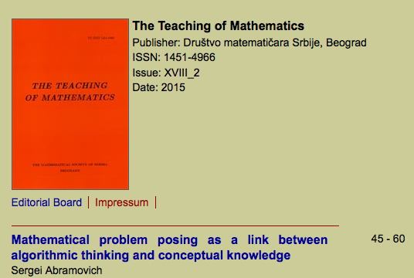
http://elib.mi.sanu.ac.rs/files/journals/tm/35/tmn35p45-60.pdf

Slide 26
THANK YOU
abramovs@potsdam.edu
http://www2.potsdam.edu

